Slide 1
45 Day Check-in
Dunbar Elementary School GO Team Meeting #3
11/17/2022

Slide 2
Agenda
CIP-45 Day Check-in
Fall ACES Presentation
School Strategic Plan
Discussion on Strategic Plan and progress
Updates for Strategic Plan (as necessary)
Preparing for the Budget Development
Rank Strategic Priorities

Slide 3
Timeline for GO Teams
You are HERE
Fall 2021
GO Team Developed 2021-2025 Strategic Plan
1
Summer 2022
School Leadership completed Needs Assessment and defined overarching needs for SY22-23
2
August 2022
School Leadership completed 2022-2023 Continuous Improvement Plan
3
Sept. – Dec. 2022
Utilizing current data, the GO Team will review & possibly update the school strategic priorities and plan
4
Before Winter Break
GO Team will take action (vote) on the school’s strategic plan and vote on the ranked strategic plan priorities for SY23-24 budget discussions.
5
1
2
3
4
5

Slide 4
Quarterly CIP Check-in
As part of the Continuous Improvement process, all APS schools are completing a quarterly check-in for the Continuous Improvement Plans.
Questions to Consider
Based on our year long CIP plan, what are the actions that the school has already completed?​
What data supports the completion of an action step and success criteria (both implementation and student achievement)?

Slide 5
Quarterly Continuous Improvement Check-In
School Name: Paul L. Dunbar Elementary School | Associate Superintendent: Dr. Kala Goodwine
Continuous Improvement Plan Goal #1: Implement rigorous, culturally relevant, and linguistically responsive curriculum with fidelity in ELA strengthening instructional best practices in Tier 1 instruction.
Completed Action Steps | Evidence of Completed Actions Steps (Implementation or Student/Teacher progress data) | Artifacts available
1. Implement interdisciplinary units with integrated literature from IB Planners with fidelity and consistency. | IB Units have been completed on each grade level | Toddle Entries IB Padlet
2. Plan and implement professional development for Guided Reading, Phonics, and Writing | Guided Reading PL has been provided during Pre-Planning as well as collaborative planning | Agendas, PLC Presentions
3.
Summary of next steps and district support needed to continue progress: Nothing needed at this time.
Action Steps in Progress | Anticipated Date of Completion | Necessary Resources to Complete Step
Implement Fountas & Pinnel & Fundations (Phonics) with fidelity. | May 2023 | Instructional coaches and Literacy content Specialists
Support teachers with the implementation of the literacy and intervention block through ongoing observations/feedback, coaching, and monitoring. | May 2023 | Admin, Coaches, and Content Specialists
Implement writing curriculum with fidelity with differentiated supports for students | May 2023 | Admin, Coaches, and Content Specialists
Summary of next steps and district support needed to complete action steps currently in progress: Periodic monitoring/observations by Content Specialists and other Teaching and Learning staff.
Pending Action Steps | Anticipated Start Date | Necessary Resources to Begin/Complete Step
Summary of next steps and district support needed to start action steps:
Notes:
Analyze progress towards CIP goal #1

Slide 6
Quarterly Continuous Improvement Check-In
School Name: Paul L. Dunbar Elementary School | Associate Superintendent: Dr. Kala Goodwine
Continuous Improvement Plan Goal #2: Implement consistent, rigorous, and problem-based curriculum with fidelity in Math strengthening instructional best practices in Tier 1 instruction.
Completed Action Steps | Evidence of Completed Actions Steps (Implementation or Student/Teacher progress data) | Artifacts available
1.
2.
Summary of next steps and district support needed to continue progress:
Action Steps in Progress | Anticipated Date of Completion | Necessary Resources to Complete Step
Students will participate in weekly fluency activities and extracurricular activities focused on math content. | March 2023 | Fluency Resources and Activities
Student progress/growth will be monitored through the use of pre- and post- assessments and Exit Tickets | May 2023 | MAP Data and Data Talk Protocols
Plan and implement professional development for effective number talks, problem solving and content knowledge | March 2023 | District Math Curriculum Resources and Content Specialists
Provide ongoing observations/feedback, coaching, and monitoring to support teachers with the implementation of effective math instruction (instructional strategies, differentiation and vocabulary) | May 2023 | Coaching Cycle and Schedule
Summary of next steps and district support needed to complete action steps currently in progress:
Pending Action Steps | Anticipated Start Date | Necessary Resources to Begin/Complete Step
Summary of next steps and district support needed to start action steps:
Notes:
Analyze progress towards CIP goal #2

Slide 7
Quarterly Continuous Improvement Check-In
School Name: Paul L. Dunbar Elementary School | Associate Superintendent: Dr. Kala Goodwine
Continuous Improvement Plan Goal #3: Implement a Whole-Child system of supports that integrates social-emotional learning, behavior, wellness, and comprehensive academic intervention plans
Completed Action Steps | Evidence of Completed Actions Steps (Implementation or Student /Teacher progress data) | Artifacts available
1.
2.
Summary of next steps and district support needed to continue progress:
Action Steps in Progress | Anticipated Date of Completion | Necessary Resources to Complete Step
Utilize the Behavior Specialist & Counselor to provide behavior management strategies, SEL and professional development to teachers. | May 2023 | FT BS & Counselor, CARE TEAM, and SEL Resources
Host school-wide virtual assembly that reviews behavioral expectations, IB Learner Profiles, rewards, and PBIS Matrix review. | April 2023 | Admin, Counselor, B Spec., IB Coordinator
Provided and implement Restorative Practices PL and strategies to students and staff. | May 2023 | Trainings for new staff
Schedule and host parent workshops on effective communication strategies for students and conflict resolution | October 2022, January 2023 | District Engagement Office
Schedule monthly CARE Team meetings and use data from the BASC3 BESS diagnostic to support students in the SST/RTI process in alignment with the APS 5 | May 2023 | CARE Team Tracker and Rolling Agenda
Summary of next steps and district support needed to complete action steps currently in progress: None at this time.
Pending Action Steps | Anticipated Start Date | Necessary Resources to Begin/Complete Step
Summary of next steps and district support needed to start action steps:
Notes:
Analyze progress towards CIP goal #3

Slide 8
Accountability
Collaboration
Equity
Support
NOTE to Principal: Please insert your ACES presentation after this slide.
Fall 2022 ACES Presentation

Slide 9
5 years
2
5 years
0
IB
In Progress
November 2022
Teaching and Learning
Student Academic Ownership
N/A (<10 students)
288
21 students
301
N/A (<10 students) (29 TD)
-13

Slide 10
Indicator | Time Frame
 | September 2021 | September 2022
Attendance Take Rate | 100% | 100%
ADA Attendance Rate | 87.9% | 91.3%
Students not chronically absent | 54% | 72.6%
0.09
Subgroup | Total number of students | OSS Suspension Rate
Female | 145 | 0
Male | 142 | .17
SWD | 19 | 0
Black | 274 | 0.07
Hispanic | N/A | N/A
Multi-race | N/A | N/A
White | N/A | N/A
Asian | N/A | N/A
*As of 10/02/2022
*As of 09/28/2022
Notes:
ACES 2.0 School culture
Restorative practices
Family engagement

Slide 12
Program | Avg. Daily Use (Mins) |  | Avg. Weekly Use (Days)
 | Spring 2022* | Fall 2022** | Spring 2022 | Fall 2022
System 44 | 22.4 minutes | 18.3 minutes | 2.8 days | 2.4 days
iRead | 29.9 minutes | 29.3 minutes | 2.7 days | 2.0 days
*Spring 2022: As of April 30, 2022
**Fall 2022: As of September 16th, 2022

Slide 13
 | CIP Strategy | Action Step Progress Update
ELA | Implement rigorous, culturally relevant, and linguistically responsive curriculum with fidelity in ELA strengthening instructional best practices in Tier 1 instruction. | Support teachers with the implementation of the literacy and intervention block through ongoing observations/feedback, coaching, and monitoring. Progress Update: The A Team has been diligent on using the coaching schedule/tracker to provide coaching supports to assigned teachers on a 2-week cycle.
Math | Implement consistent, rigorous, and problem-based curriculum with fidelity in Math strengthening instructional best practices in Tier 1 instruction. | Students will participate in weekly fluency activities and extracurricular activities focused on math content. Progress Update: Students have been making progress by increasing math fluency of math facts based on Friday Fluency Days.
Whole Child & Student Support | Implement a Whole-Child system of supports that integrates social-emotional learning, behavior, wellness, and comprehensive academic intervention plans. | Schedule monthly CARE Team meetings and use data from the BASC3 BESS diagnostic to support students in the MTSS process in alignment with the APS 5. Progress Update: The CARE Team/SAC has met consistently on Mondays at 3PM and have been supporting students needs. Behavior plans have been developed and are being implemented by AP, BS, and Counselor.
Family Engagement | Provide opportunities for parents to be actively engaged in the learning experiences of students monthly throughout the school year. | Provide opportunities for parents to be actively engaged in the learning experiences of students monthly throughout the school year. Progress Update: Monthly “Main Event” parent workshops/events are scheduled and have been averaging 70 or more parents per event with positive parent survey feedback.

Slide 15
What support do you need to accomplish your SY23 goals?
Currently, the highest priority need for Dunbar is assistance with Math content knowledge for teachers coupled with instructional framework design to address the differentiated needs of students. Our goal is to focus on grade level content along with providing opportunities for mastery of math fluency and problem solving strategies. Although we see some gains in MAP for math from Fall 2021 to Fall 2022, we want to keep that momentum and gain 15% or higher of proficient and distinguished students.

Slide 17
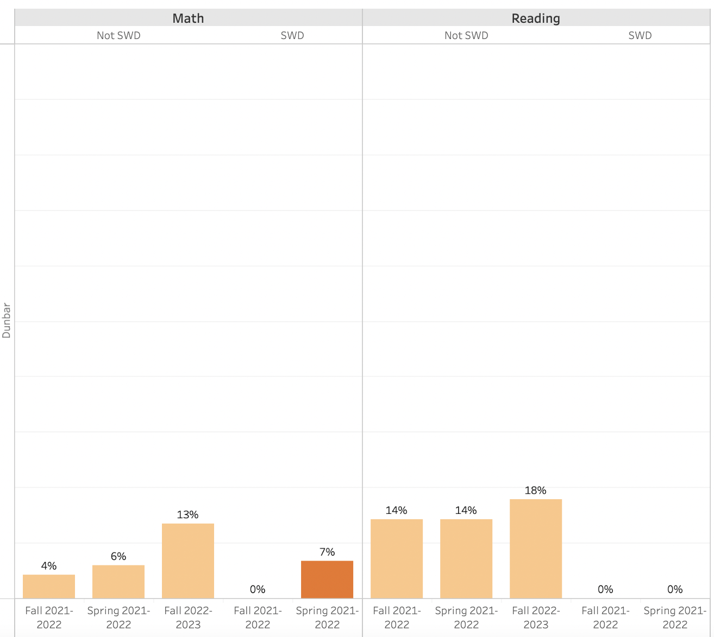

Slide 18
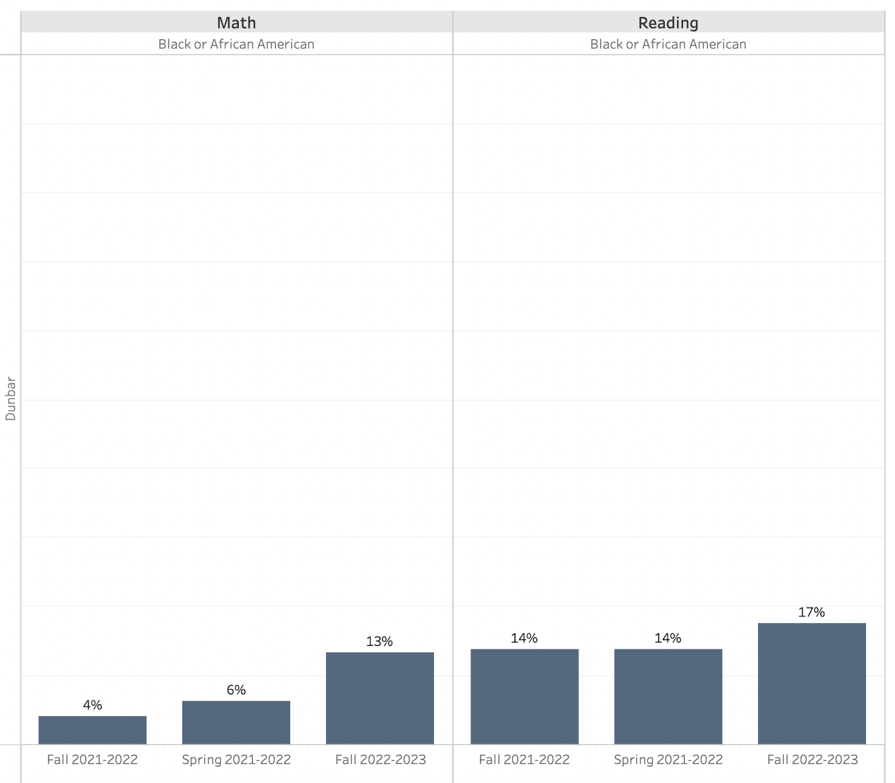

Slide 19
Strategic Plan Progress

Slide 20
Mission-Paul Laurence Dunbar Elementary is a school that nurtures and develops life- long learners who are problem solvers and internationally minded citizens.
Paul L. Dunbar Elementary
Vision-Paul Laurence Dunbar is a school where excellence is expected and all students are developed academically, socially, and emotionally in order to become globally competitive.
SMART Goals
Increase the % of grades 3-5 students scoring proficient or above in reading from 17% Spring GMAS 2019 to 20% on Spring GMAS 2022
Increase the % of grades 3-5 students scoring proficient or above in math from 15% on Spring GMAS 2019 to 18% on Spring GMAS 2022
Reduce the number of insubordinate behavior referrals by 10% from 2019 to 2021-2022 SY
Increase parent participation in school hosted events
APS Strategic Priorities & Initiatives
School Strategic Priorities
School Strategies
Fostering Academic Excellence for All
Data
Curriculum & Instruction
Signature Program
1. Weekly Data Review PLCS
2. International Baccalaureate school-wide implementation
3. Focus on Literacy and Math instructional best practices
1A. Review of NWEA/MAP, HMH, Attendance, and Behavior Data weekly
1B. Quarterly Parent Teacher Data Conferences
1C. Learning Walks for Intervention, Guided Reading, IB, and Math
Building a Culture of Student Support
Whole Child & Intervention
Personalized Learning
Intervention Block with HMH
After School Tutorial/Saturday School
BASC-3 Behavior Screener
Weekly CARE Team Meetings
2A. Care Team weekly meetings and student tracker
2B. Pre and Post Data for students attending after school tutorial
2C. Full-time Wrap-Around Supports (Counselor, Behavior Specialist, MTSS, Social Worker)
Equipping & Empowering Leaders & Staff
Strategic Staff Support
Equitable Resource Allocation
8. Innovative Lead Teacher (LIT Squad)
9. Leadership Development Opportunities (Coordinators;Club Sponsors)
10. ESOL,SPED, & Homeless Inclusion
3A. PLC Norms and Protocols
3B. After School Coordinator Leadership Opportunities and Planning Meetings
3C. Allocation of General Budget and other funding sources for ESOL, SPED, & Poverty Students
Creating a System of School Support
Collective Action, Engagement & Empowerment
4A. Monthly School Newsletters
4B. Monday Folder communication of flyers and announcements
4C. Social Media Blasts
4D. Robo Calls and Class Dojo
11. Community Partners Network
12. On-Campus AVLF resources
13. Parent Liaison and Parent Center
14. Community CARE Closet
15. Sheltering Arms Educare Center

Slide 21
Activity & Discussion
Review the priorities and goals in your strategic plan and reflect on if the expected progress is being made. These guiding questions will help you determine what, if any, updates are needed for your school’s strategic plan.
Are all CIP Goals reflected in our Strategic Plan Priorities? If not, which CIP Goal(s) are missing and should be added to the Strategic Plan?
What progress has been made towards the priorities identified in our Strategic Plan? What evidence/data do we have?
Based upon available data, are there any other adjustments we need to make to the Strategic Plan?

Slide 22
Updates to the
Strategic Plan
Enter all changes/updates to your plan – be sure to include accountability measures, as appropriate.

Slide 23
Questions?
Wonderings?
Comments?

Slide 24
Preparing for Budget Development

Slide 25
You are HERE
Fall 2021
GO Team Developed 2021-2025 Strategic Plan
1
Summer 2022
School Leadership completed Needs Assessment and defined overarching needs for SY22-23
2
August 2022
School Leadership completed 2022-2023 Continuous Improvement Plan
3
Sept. – Dec. 2022
Utilizing current data, the GO Team will review & update the school strategic priorities and plan, as needed
4
Before Winter Break
GO Team will take action (vote) on the school’s strategic plan and vote on the ranked strategic plan priorities for SY23-24 budget discussions.
5
1
2
3
4
5

Slide 26
Action on the Updated Strategic Plan
The GO Team needs to TAKE ACTION (vote) on its updated Strategic Plan. After the motion and a second, the GO Team may have additional discussion. Once discussion is concluded, the GO Team will vote.

Slide 27
Discussion
Strategic Plan Priority Ranking
In preparation for the 2023-2024 Budget Development (January–March 2023), the GO Team needs to rank its Strategic Plan Priorities. Use the next slide to capture the priority ranking.

Slide 28
Strategic Plan
Priority Ranking
Insert the school’s priorities from Higher to Lower
1. Weekly Data Review PLCS
2. International Baccalaureate school-wide implementation
3. Focus on Literacy and Math instructional best practices
Higher
Intervention Block with HMH
After School Tutorial/Saturday School
BASC-3 Behavior Screener
Weekly CARE Team Meetings
8. Grade Level Leaders/LIT Squad Innovative Teachers
9. Leadership Development Opportunities (Coordinators;Club Sponsors)
10. ESOL,SPED, & Homeless Inclusion
11. Community Partners Network
12. On-Campus AVLF resources
13. Parent Liaison and Parent Center
14. Community CARE Closet
15. Sheltering Arms Educare Center
Lower

Slide 29
Action on the Strategic Plan Priorities
The GO Team needs to TAKE ACTION (vote) on its ranked Strategic Plan Priorities. After the motion and a second, the GO Team may have additional discussion. Once discussion is concluded, the GO Team will vote.

Slide 30
Where we’re going
At our next meeting(s) we will begin the discussion of the 2023-2024 budget.
Let me or the Chair know of any additional information you need for our future discussion.

Slide 31
Thank you

